Slide 1
Household Items
Then vs. Now
Source: History Nebraska

Slide 2
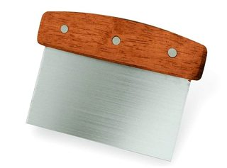
Then
Now

Slide 3
Dough Scraper
Used to clean dough off surfaces
Made from wood, metal, plastic, and silicone
Can also be used to shape the dough

Slide 4
Then
Now

Slide 5
Egg Beaters and Electric Mixer
Multiple egg beating machines were patented between 1850-1870
The first motorized mixer was patented in 1885
They weren’t adapted to everyday use until the 1920’s

Slide 6
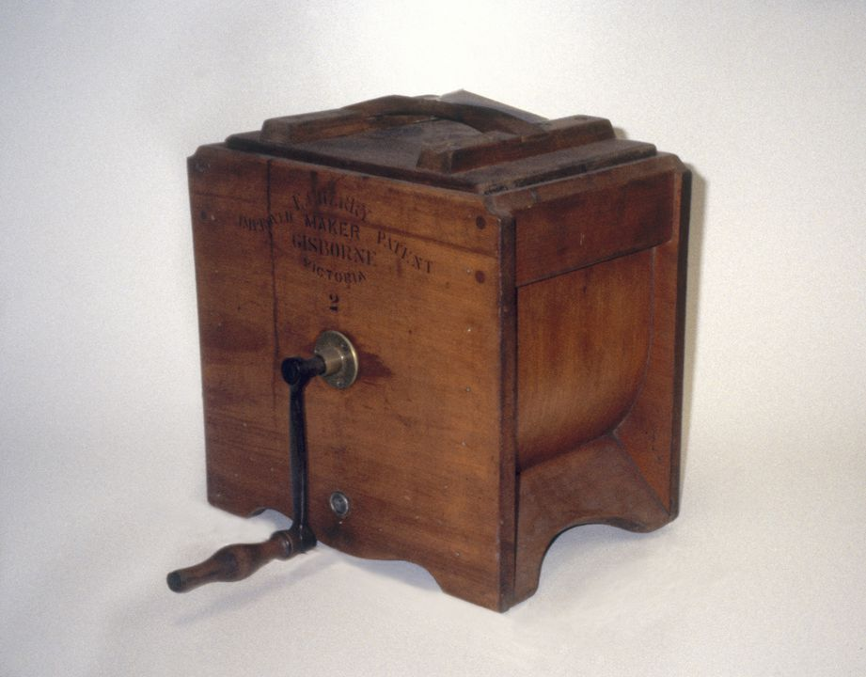
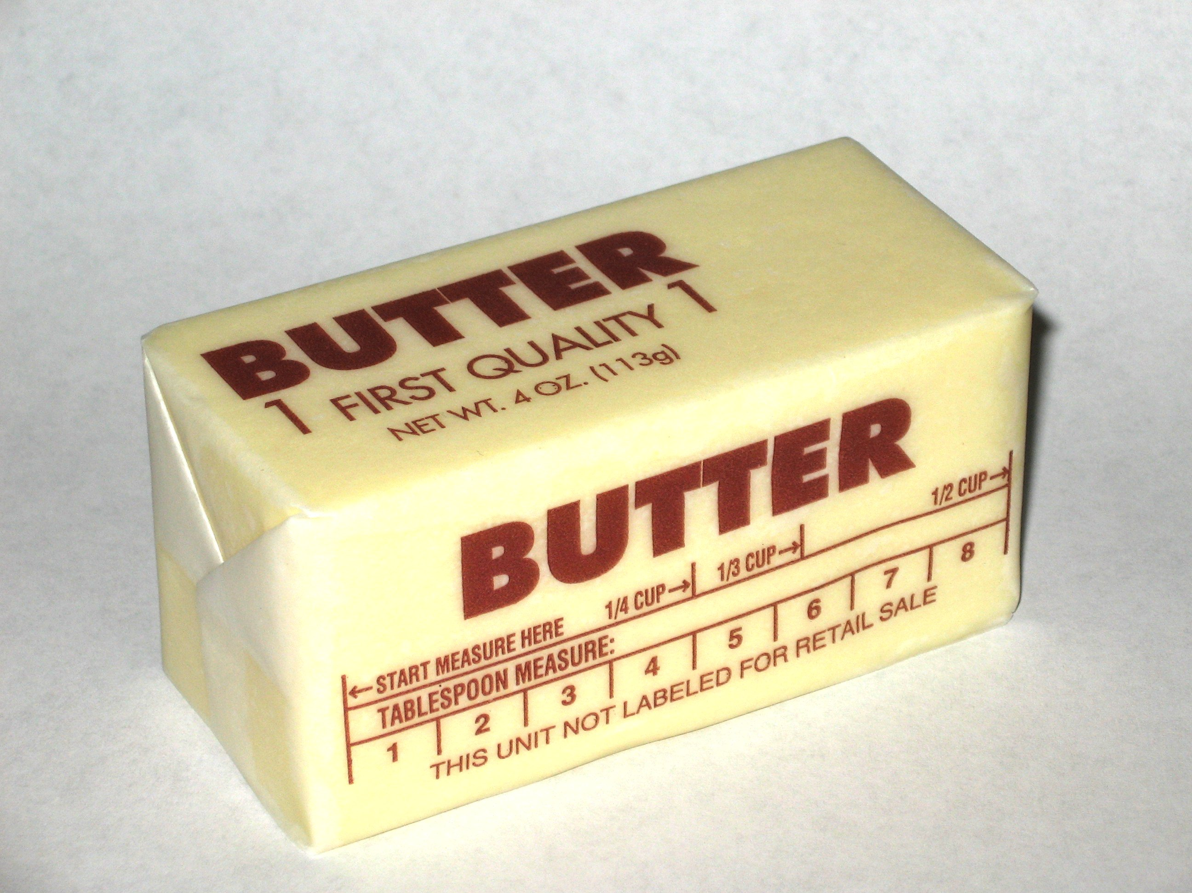
Then
Now

Slide 7
Butter Churn
Evidence of the use of butter dates back to 2000 BC
The butter churn may have existed as early as the 6th Century AD
Churning butter was seen as an important household chore

Slide 8
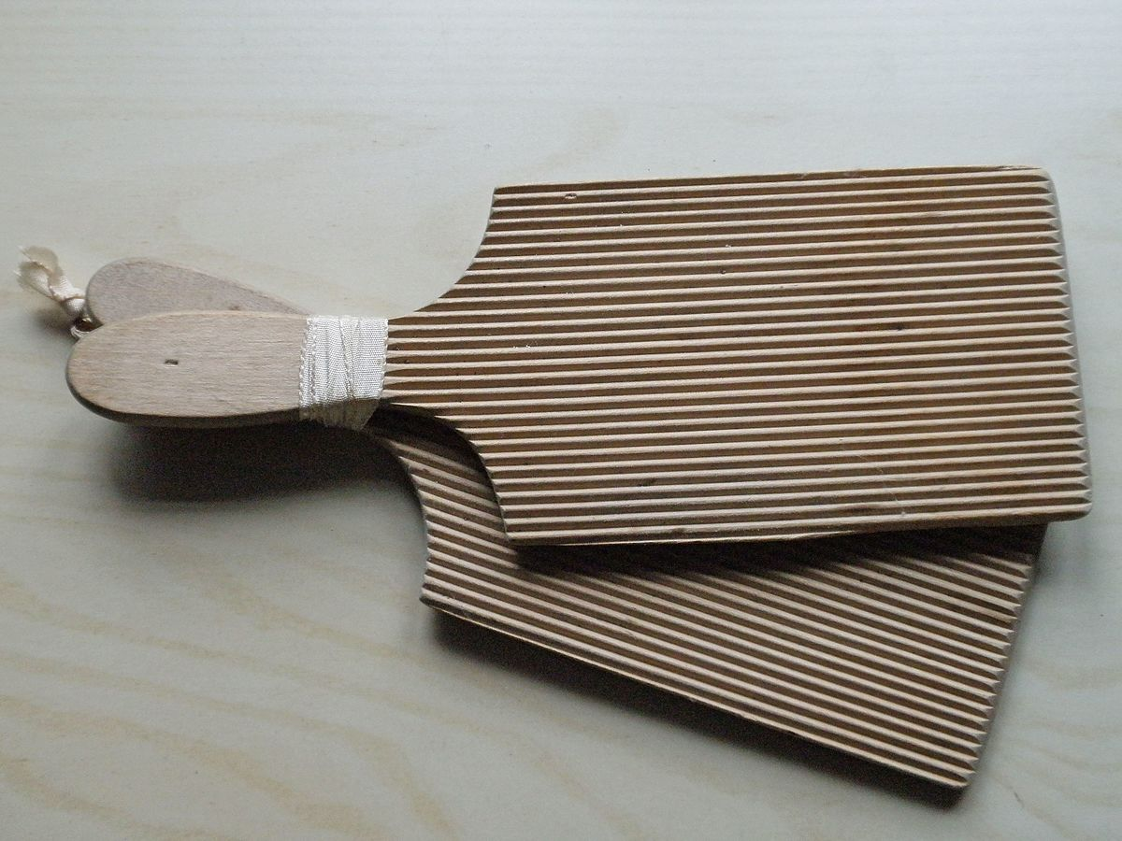
Then
Now
Butter paddles used today are almost identical to those used traditionally; however, it is rare that people make their own butter today.
This Photo by Unknown Author is licensed under CC BY-SA

Slide 9
Butter Paddle
A butter paddle is a tool used for removing the liquid out of the butter
It ensures that the butter is pure without pockets of liquid or air
It can also be used to make patterns in cake frosting or pasta

Slide 10
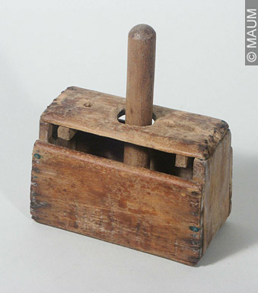
Then
Now

Slide 11
Butter, Butter Molds, and Margarine
Stories say that butter is a food fit for the gods and also promises certain immunities against evil
Butter became so popular in France that the Emperor offered prize money for an inexpensive substitute to supplement France’s inadequate butter supplies

Slide 12
Then
Now

Slide 13
Trivet
A trivet is an object placed between a serving dish or bowl and a dining table
It can also contain a receptacle for a candle that can be lit to keep food warm

Slide 14
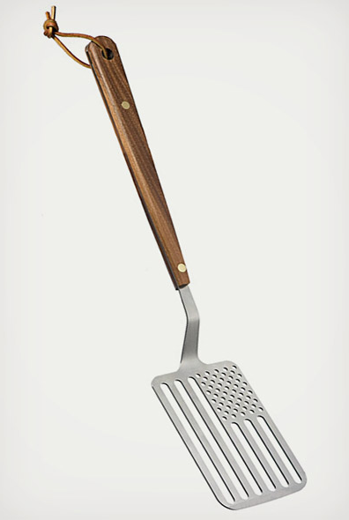
Then
Now

Slide 15
Turner or Spatula
Used to mix, spread, and lift foods
A turner and spatula are supposed to be very different kitchen utensils
A spatula is any utensil fitting the description of a flat utensil used for scraping or spreading

Slide 16
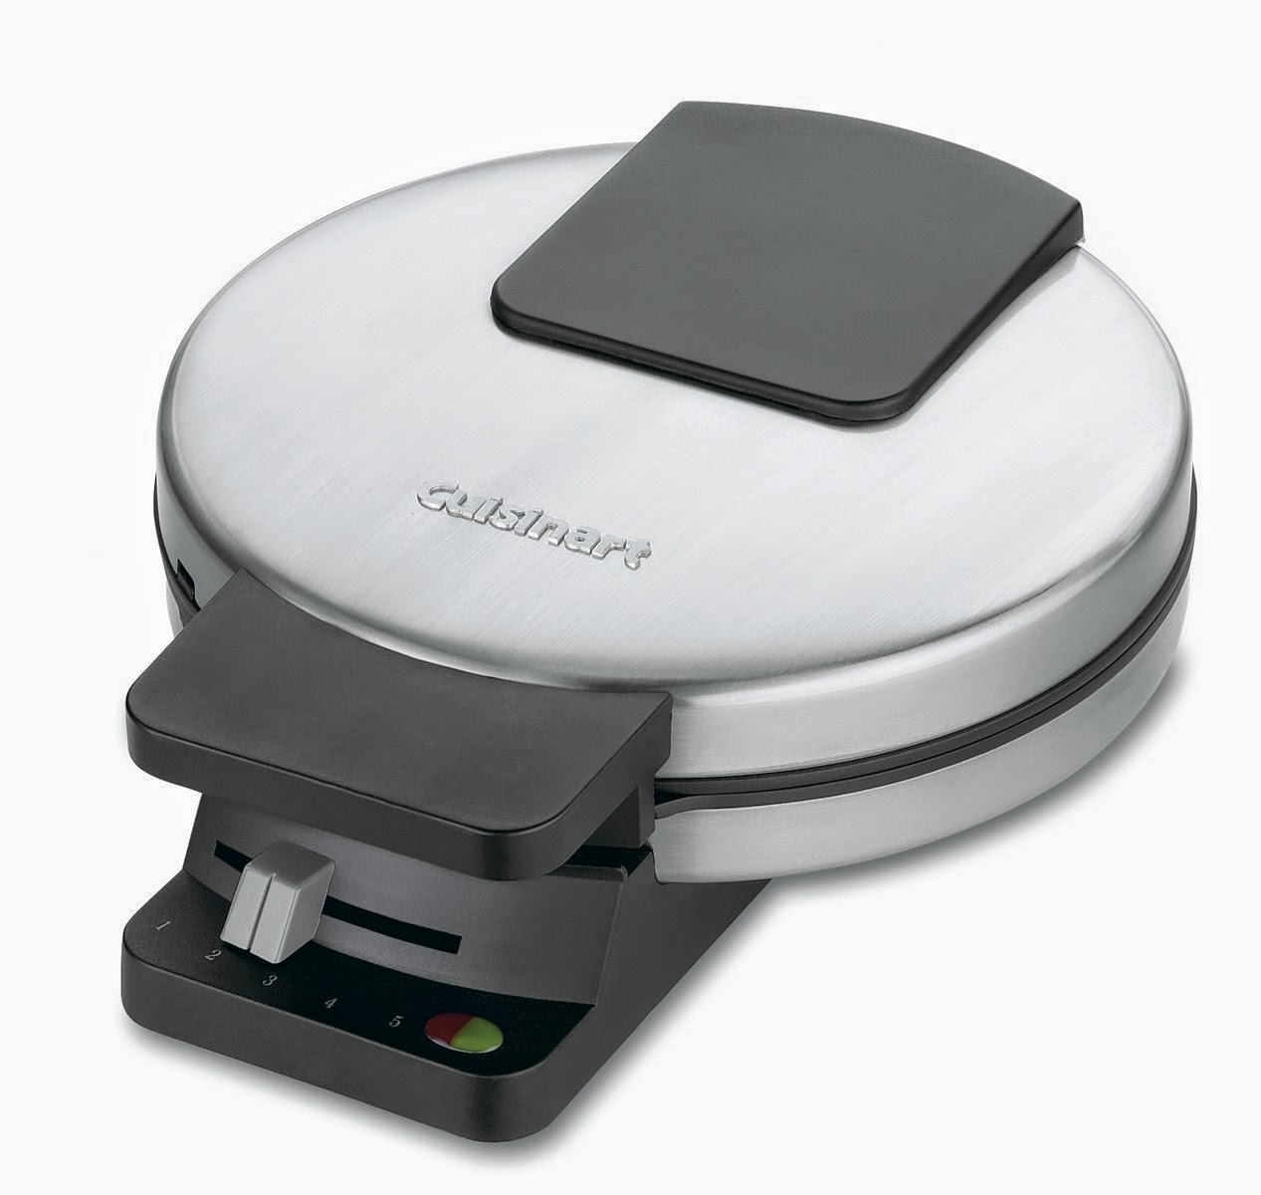
Then
Now

Slide 17
Waffle Iron
The earliest waffle irons originated in Northwest Europe around the 14th Century
The first American waffle iron was patented in 1869 and sat atop stoves to heat up
General Electric eventually made an electric powered waffle iron that looked more attractive on countertops

Slide 18
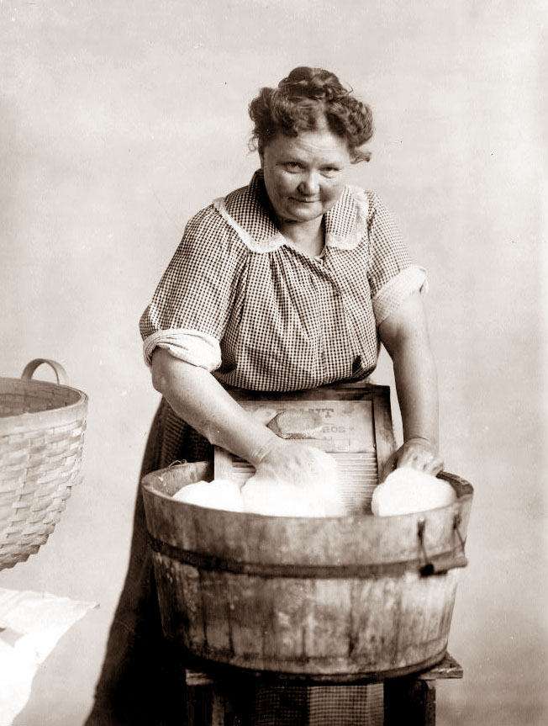
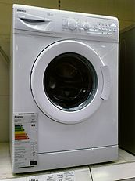
Then
Now

Slide 19
Washboard and Washing Machine
As the washer evolved, it reduced the need for vigorous manual labor
Warm soapy water was precious and would be reused to wash multiple loads

Slide 20
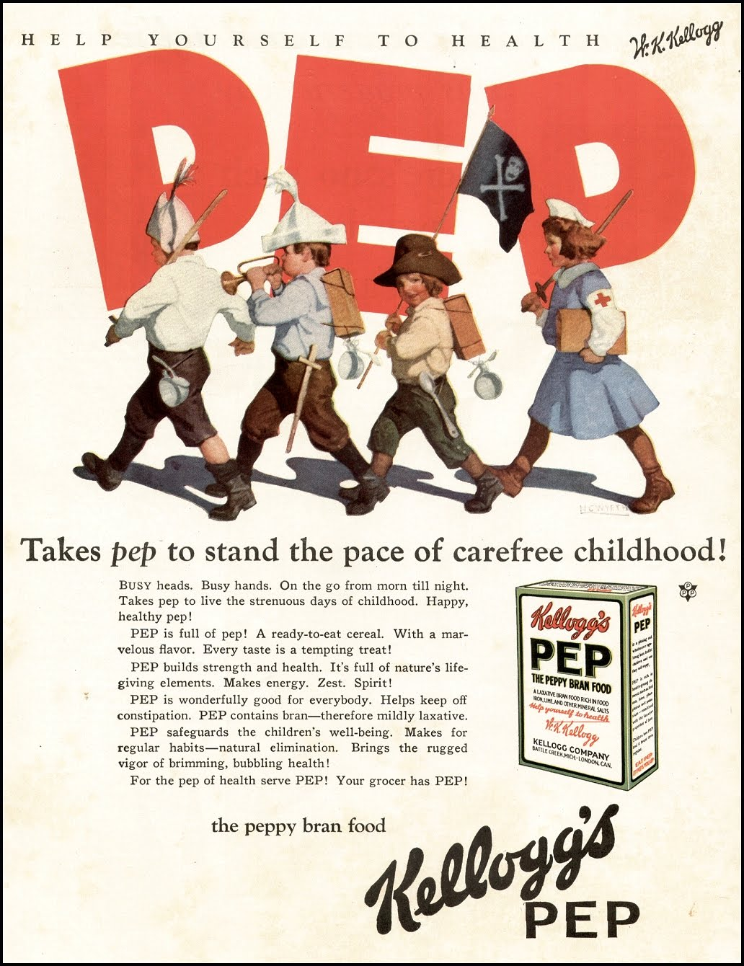
Then
Now

Slide 21
Cereal Box Prizes
Kellogg was the first to introduce prizes in boxes of cereal
This was used as a promotion technique to incentivize the public to buy a certain type of cereal

Slide 22
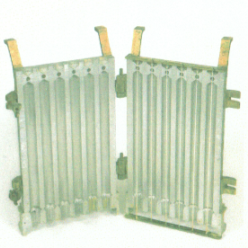
Then
Now

Slide 23
Candle Stick Mold
Molds haven’t changed much, but the material that candles are made from have
Tallow candles left an unpleasant odor and did not burn cleanly
Coal and petroleum derived paraffin waxes were clean and had a lower melting point

Slide 24
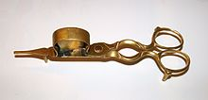
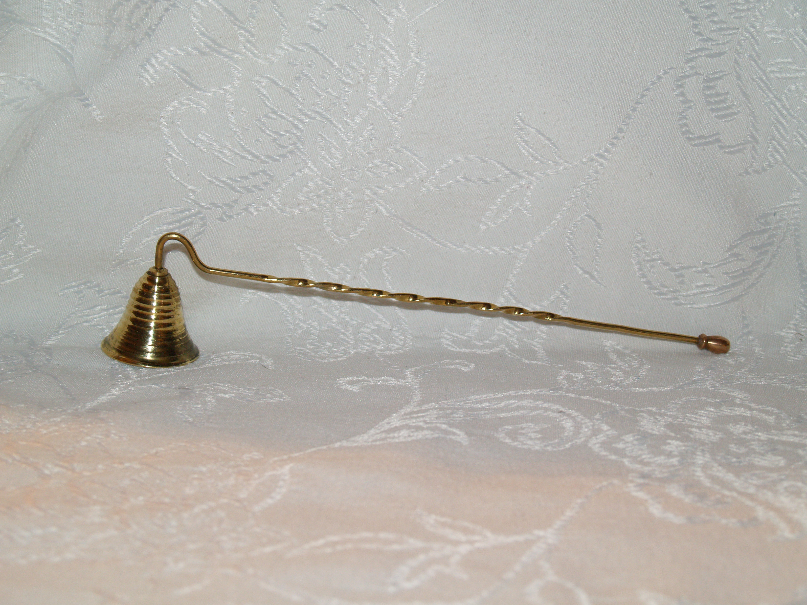
Then
Now

Slide 25
Candle Snuffer
It is an instrument used to extinguish burning candles
The scissor-like tool could be used to trim the wick of a candle; with skill, this could be done without extinguishing the flame

Slide 26
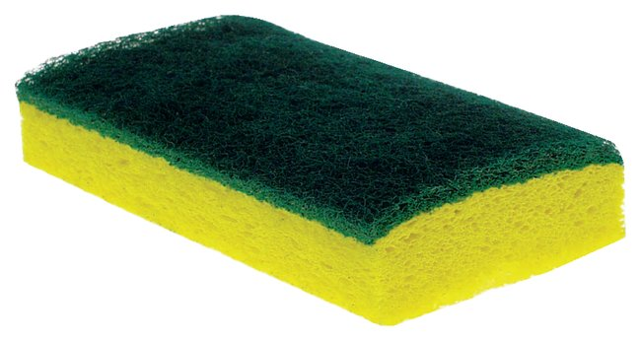
Then
Now

Slide 27
Chain Mail Pot Scrubber
They were used to clean cast iron pots in the 1920s
Cast iron cookware was especially popular in the first half of the 20th Century
With a resurgence of cooking with cast iron pots, you can still purchase chain mail pot scrubbers for use today

Slide 28
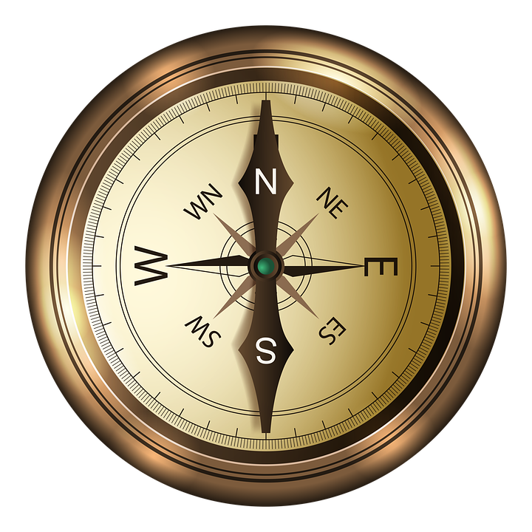
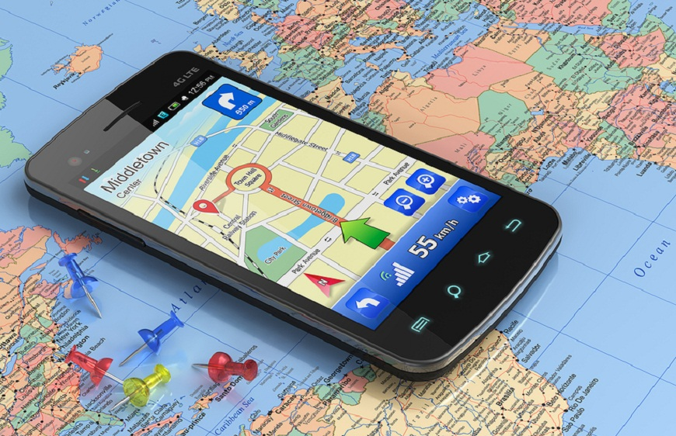
Then
Now

Slide 29
The Compass and GPS on a Car or a Cell Phone
The invention of the navigational compass is credited to ancient Chinese scholars
Modern compasses use a magnetized needle as opposed to a capsule containing oil or alcohol
Many car manufacturers claim they were the first to use GPS in their models, although it was not until 2000 that American citizens could accurately use a GPS system

Slide 30
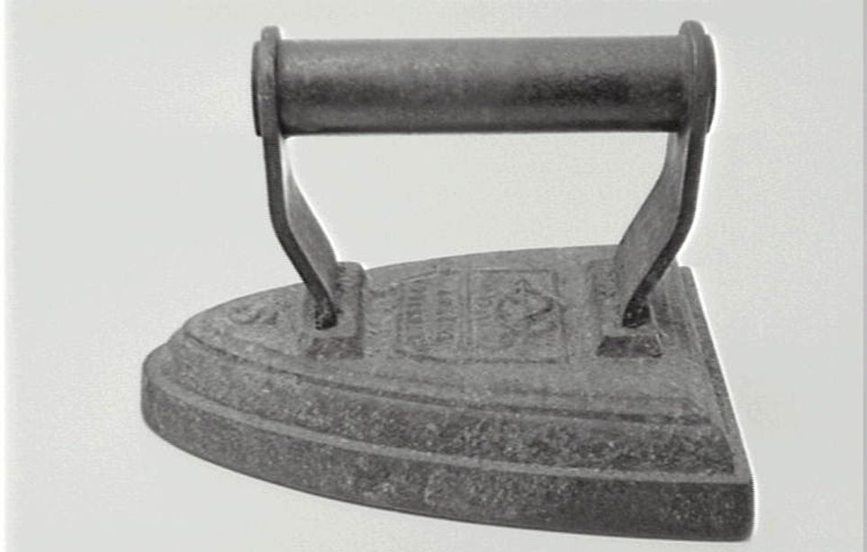
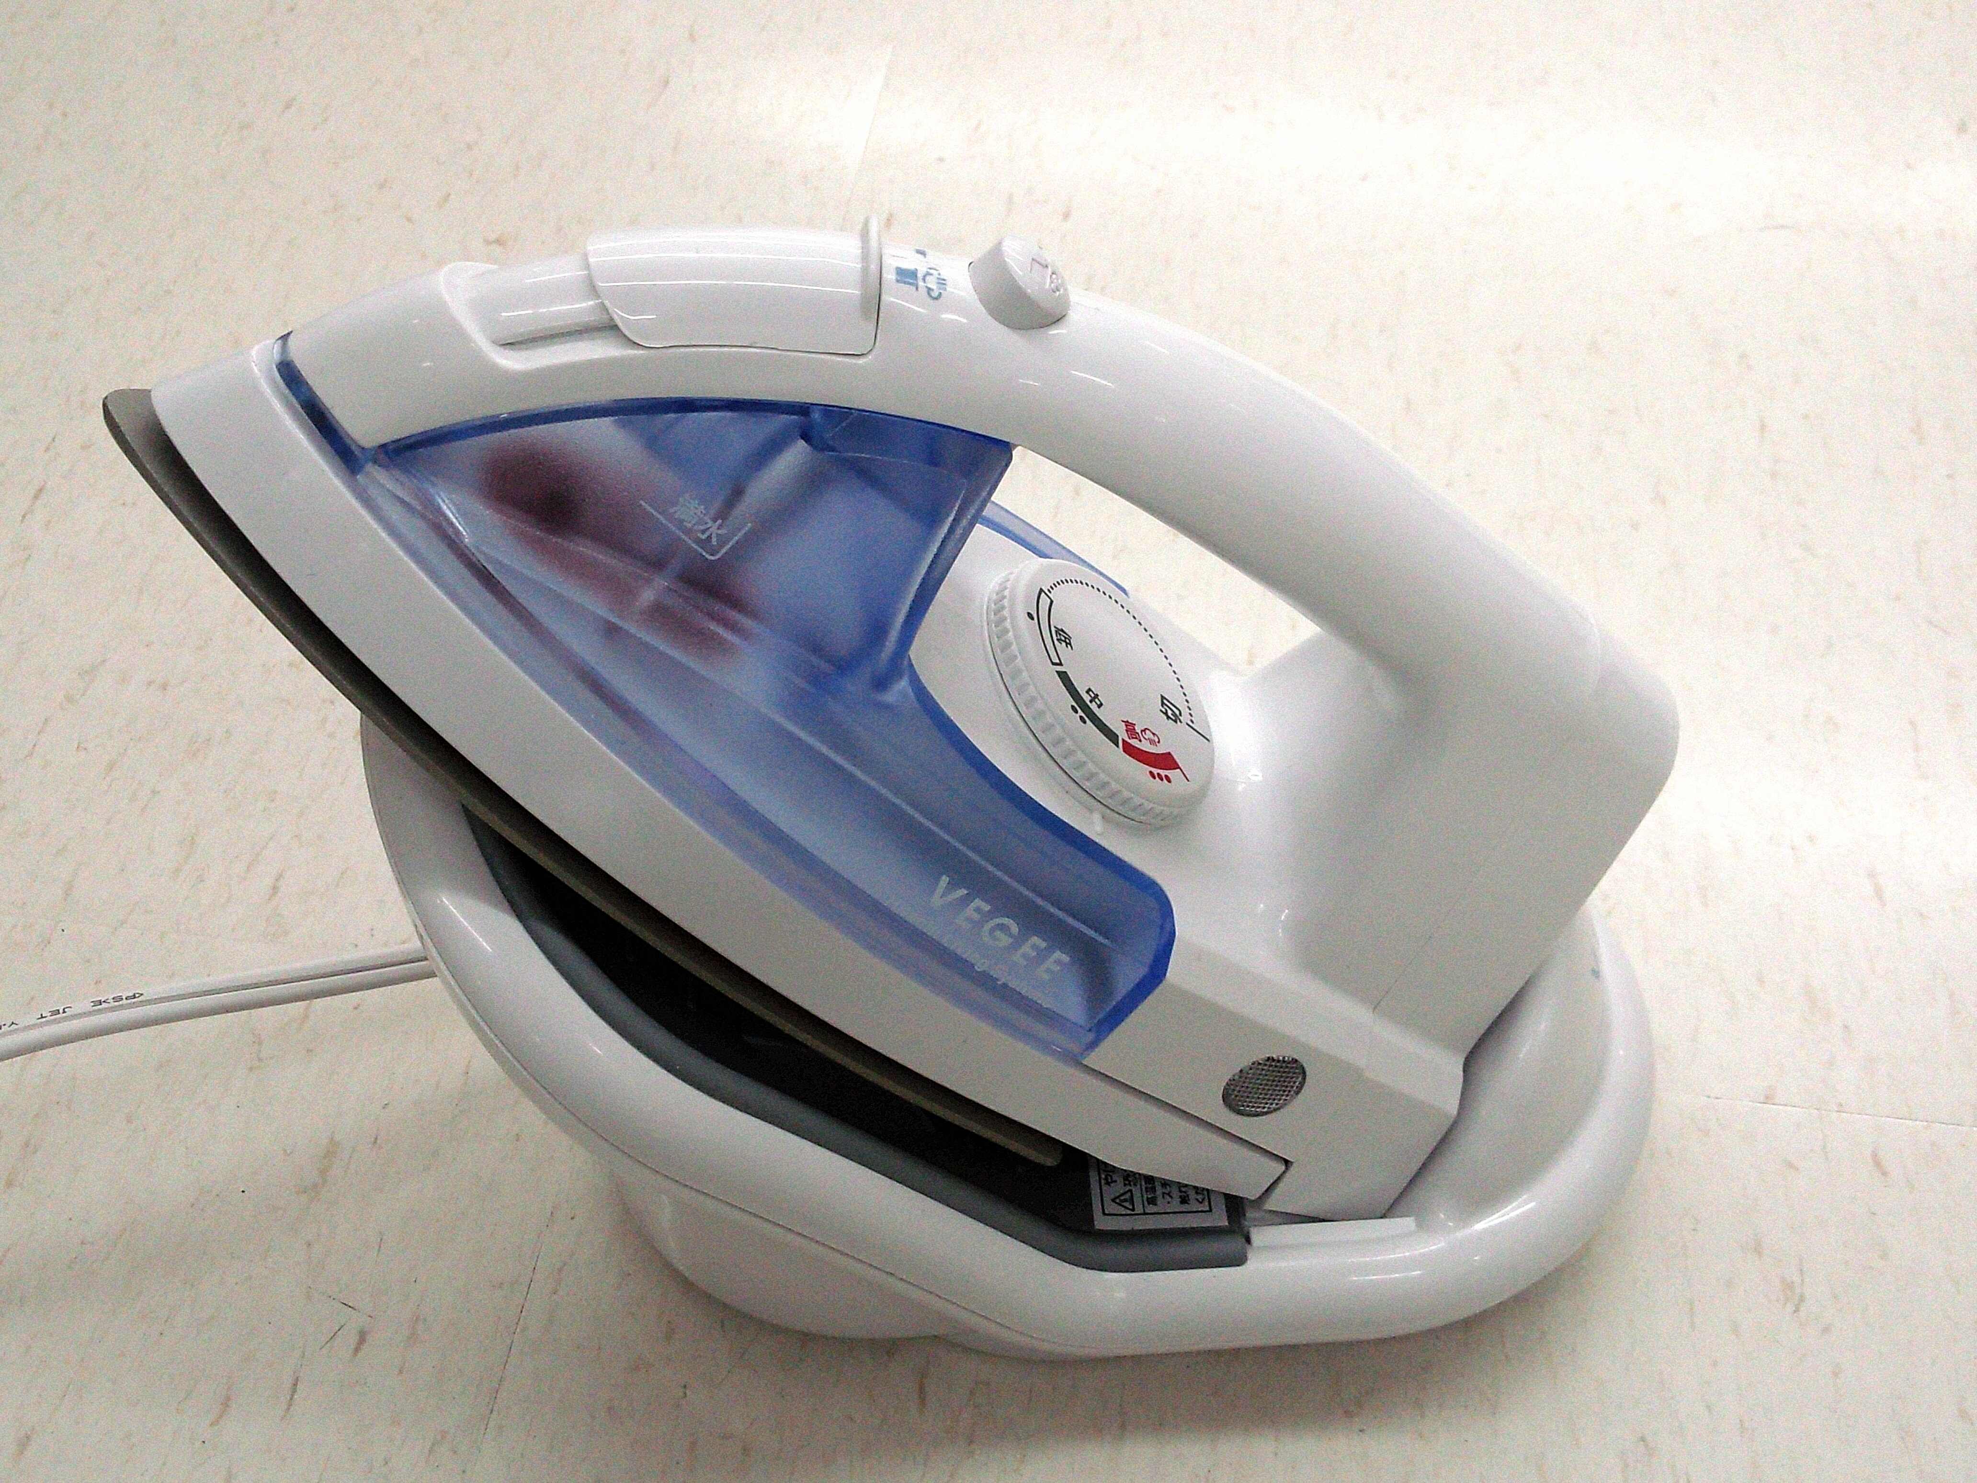
Then
Now

Slide 31
Sad Iron and Electric Iron
Nobody really knows when pressing cloth smooth really became a normal chore
The term sad irons came from an old word meaning solid
During the 20th Century, the use of an iron was internationally used regularly

Slide 32
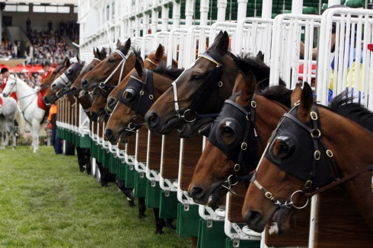
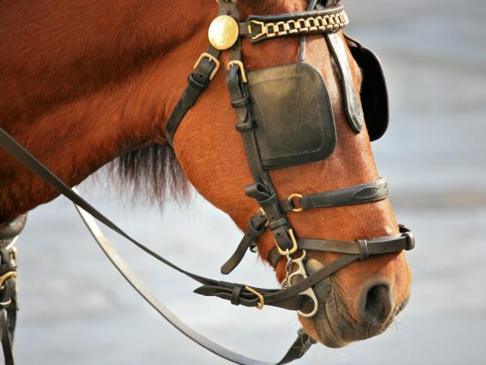
Then
Now

Slide 33
Horse Blinders
Blinders are leather side pieces attached to a horse’s bridle to prevent rear or side vision
This will keep horses from being distracted or spooked
They were invented when a preacher bet that he could make his horse walk up stairs

Slide 34
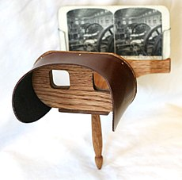
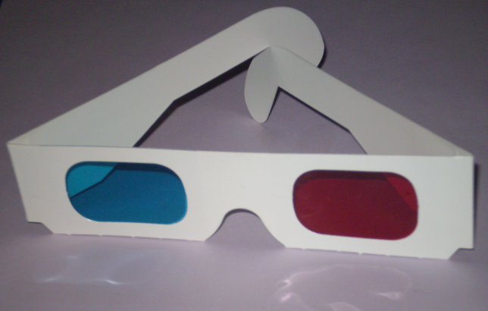
Then
Now

Slide 35
Stereoscopes and 3D Glasses
The stereoscope was invented in 1838
The first 3-d movie was developed in the 1890’s
The 1970’s were the first time that 3-d movies could be enjoyed without audience members’ eyes getting hurt

Slide 36
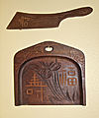
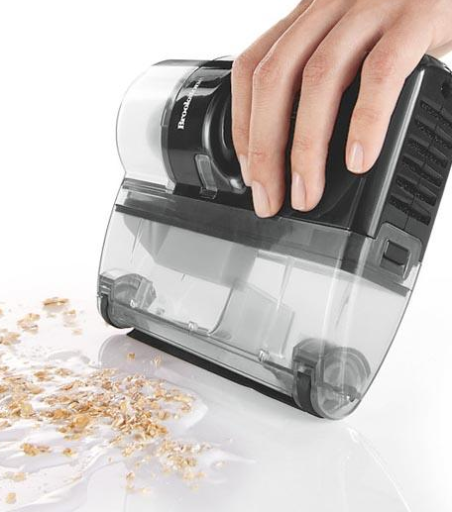
Then
Now

Slide 37
Table Crumber
A crumber brush is used during a meal to remove crumbs from a table
The inventors prided their invention on being “conveniently carried in the pocket”

Slide 38
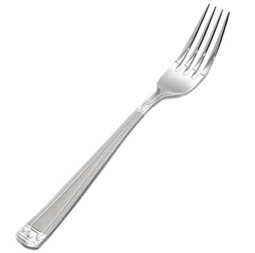
Then
Now

Slide 39
Fork
The earliest known uses of forks occurred in Ancient Egypt
Other empires were found with forks made of bone
As civilizations evolved, more forks made of metal were introduced

Slide 40
Then
Now
We don’t use these today. What do you think one might look like if we did?
Can you think of a use for an iron flute today?

Slide 41
Fluting Iron
”Fluters” were used for pressing pleats into fabric
Ladies’ and children’s clothing of the late 19th Century included a lot of pleated trim
Today a fluting iron is only used as an antique collectable

Slide 42
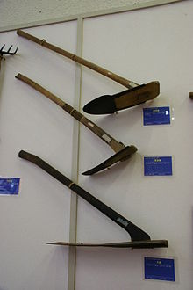
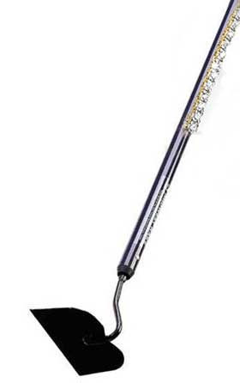
Then
Now

Slide 43
Garden Hoe
Mesopotamian civilizations used garden hoes as early as the fifth millennium BC
New World settlers realized that a clam shell would work as the perfect hoe
The Industrial Revolution led to the steel hoes that we use today

Slide 44
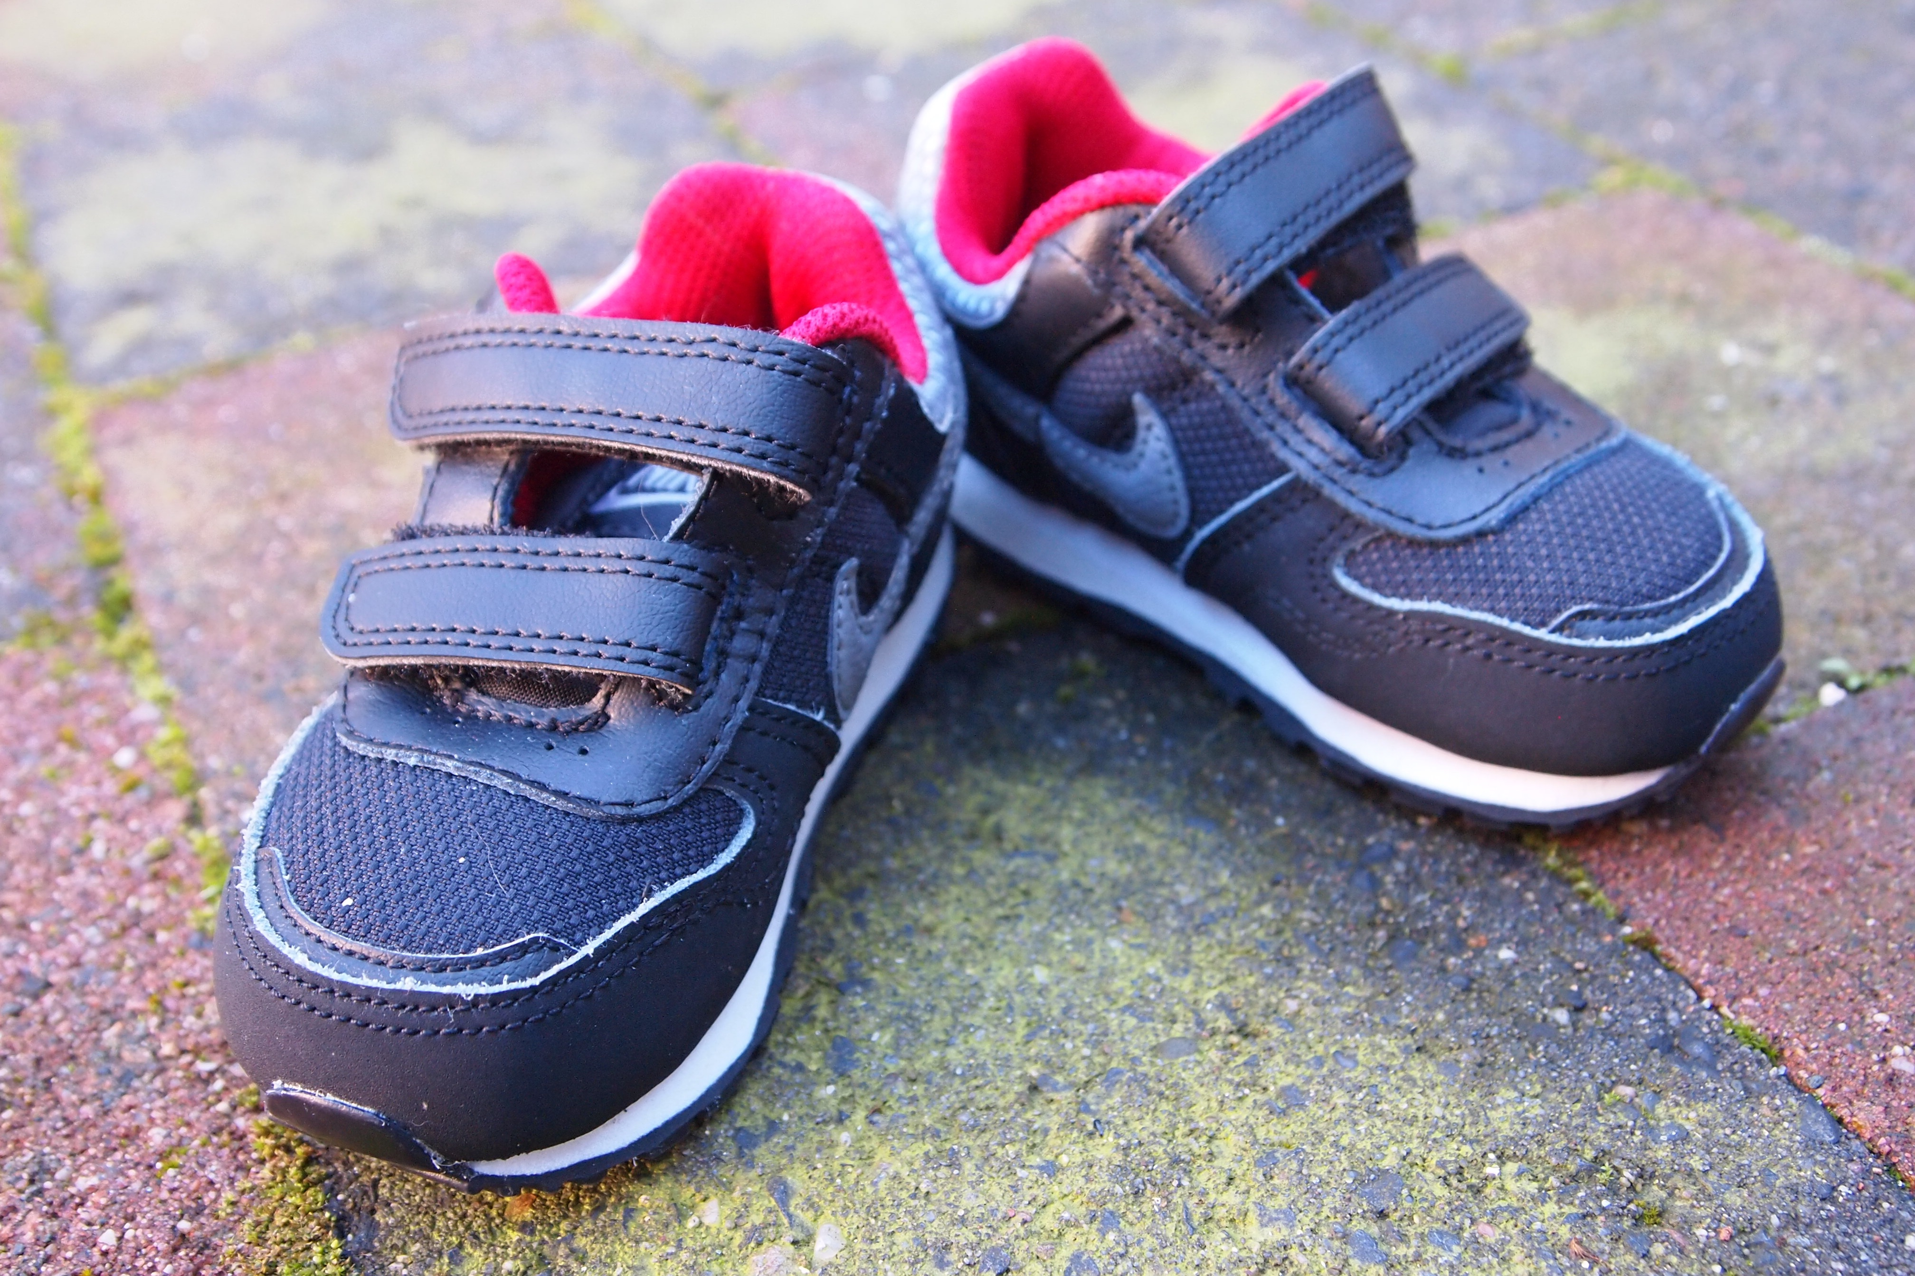
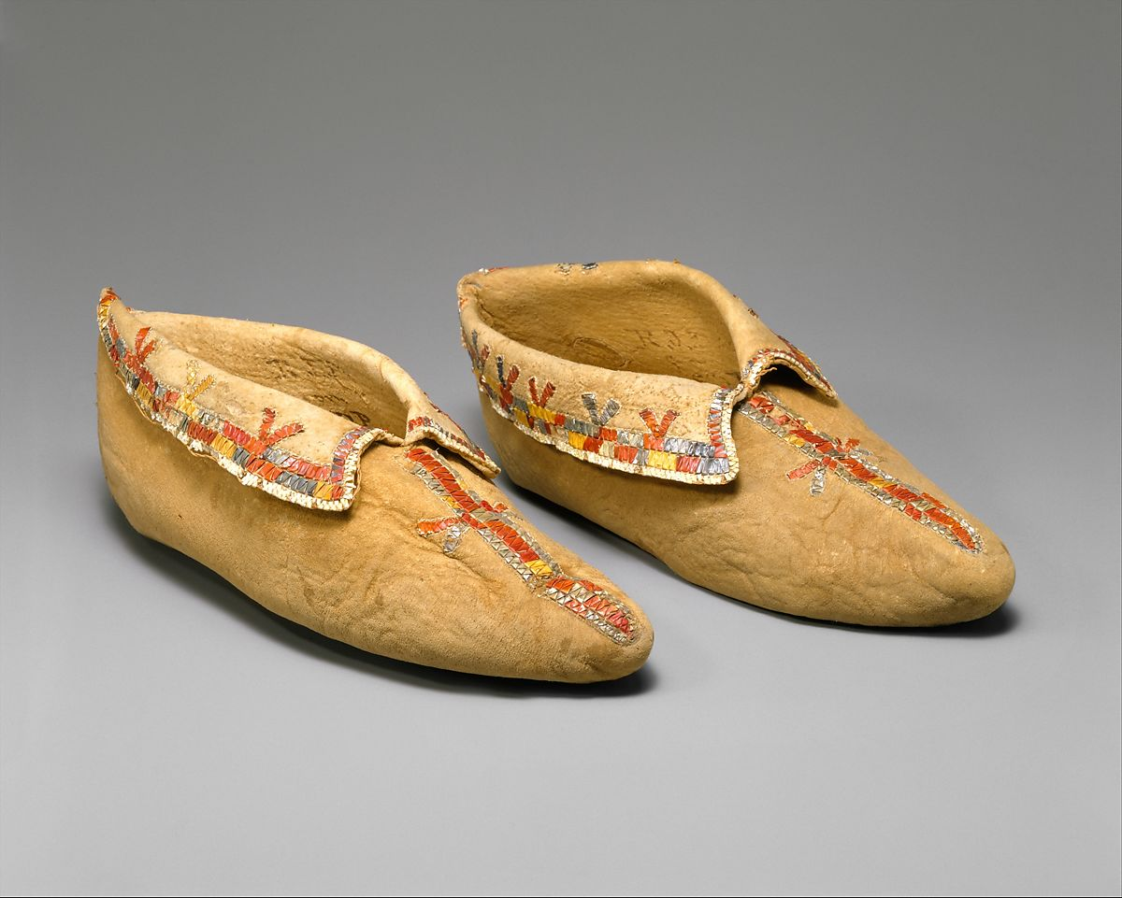
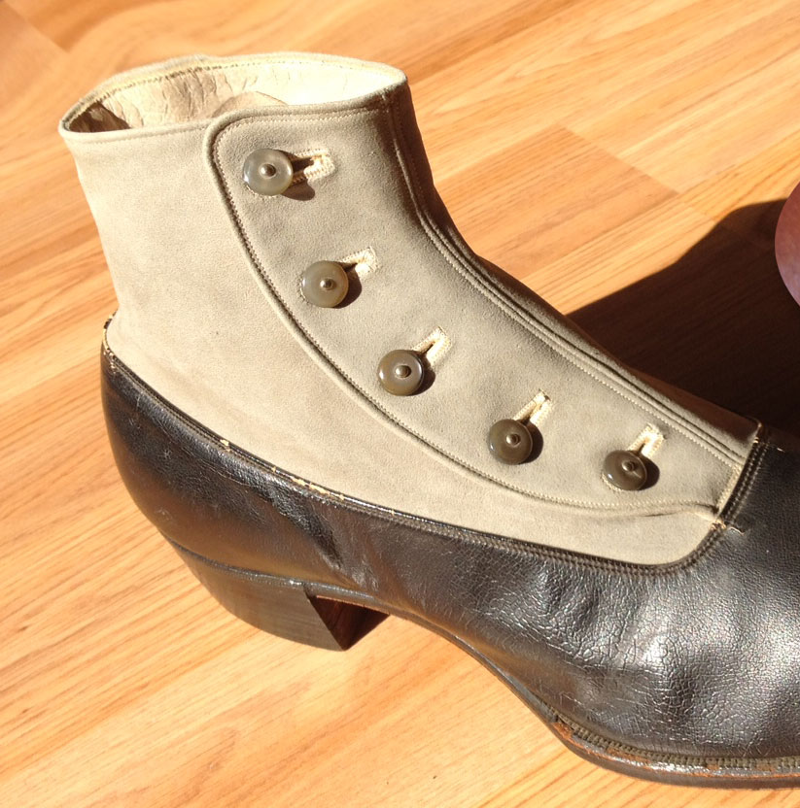
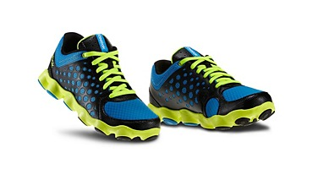
Then
Now

Slide 45
Shoes
The moccasin was created by Native Americans for protecting feet and identifying tribes
The 1870’s introduced a button- down shoe
Shoe strings were found as early as 3500 BC
Velcro shoes were invented in 1948

Slide 46
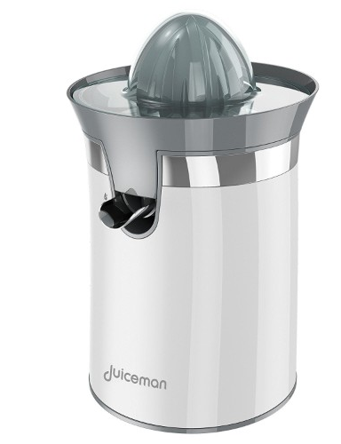
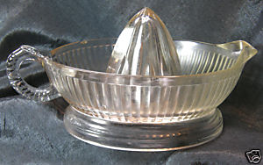
Then
Now

Slide 47
Lemon Squeezer
18th century Turkey holds the first lemon squeezers
At the end of the 19th century, the US held over 200 patents for various lemon squeezers
Their purpose was “to obtain a simple, economical and durable implement whereby lemons may be squeezed for domestic purposes with much less power.”

Slide 48
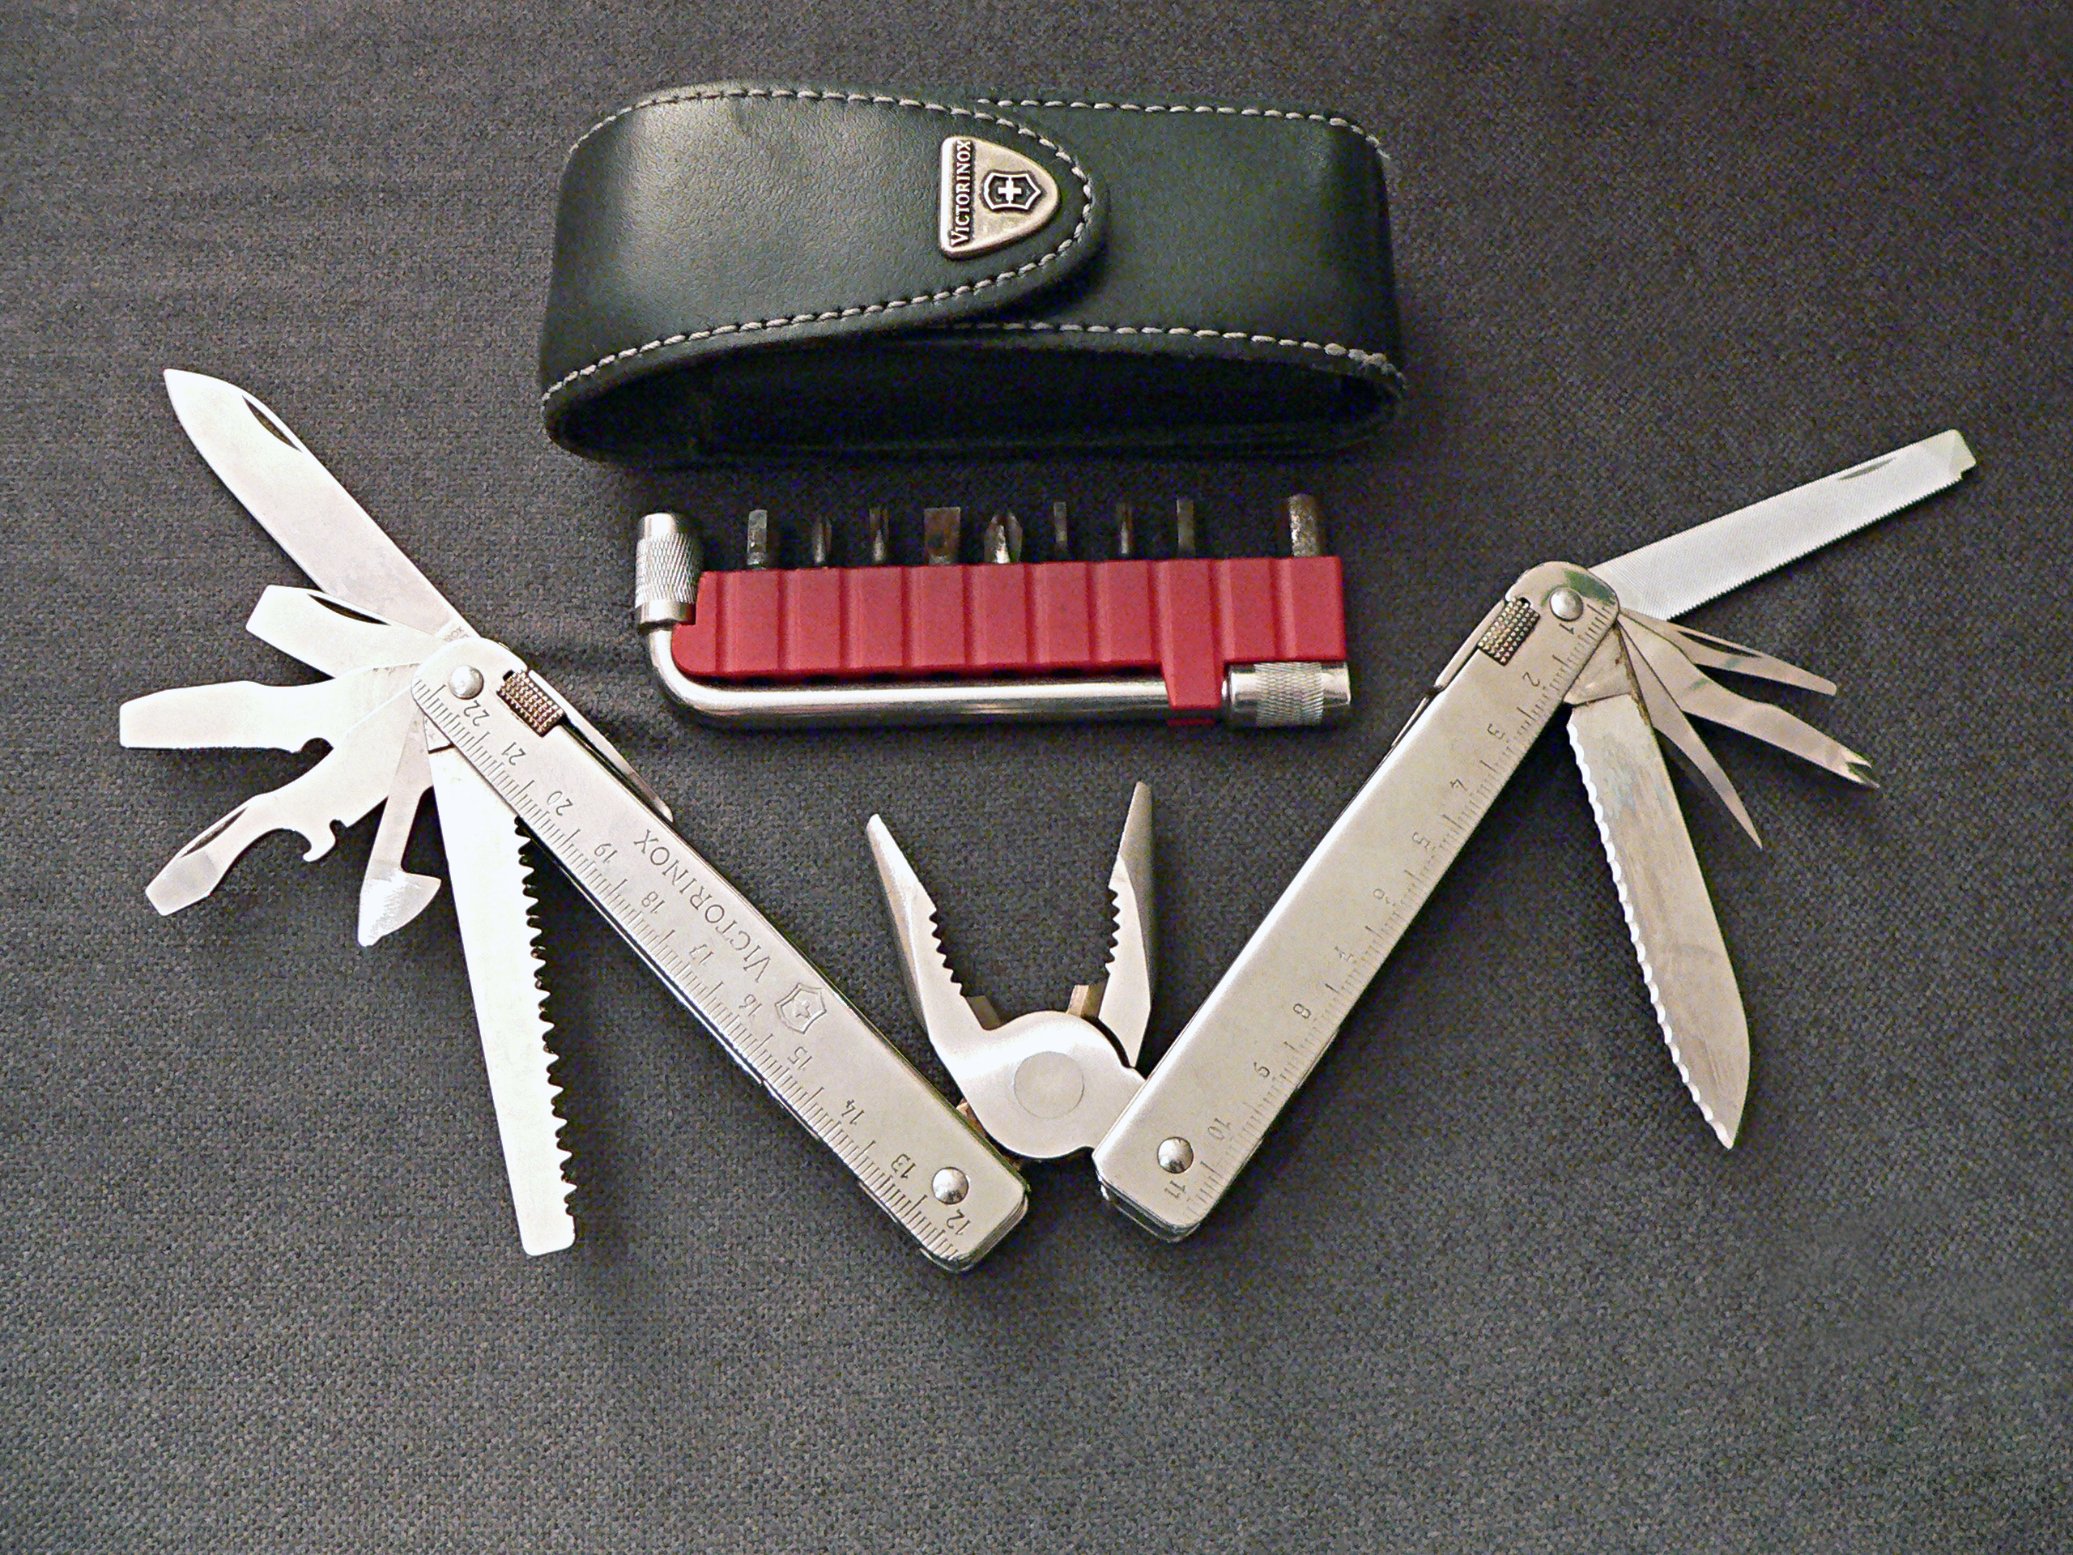
Then
Now

Slide 49
Multi-Tool
A multi-tool is a versatile hand tools that combines several individual functions in a single unit
Incorporating several tools into one unit was used back in the Middle Roman times

Slide 50
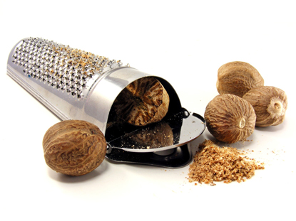
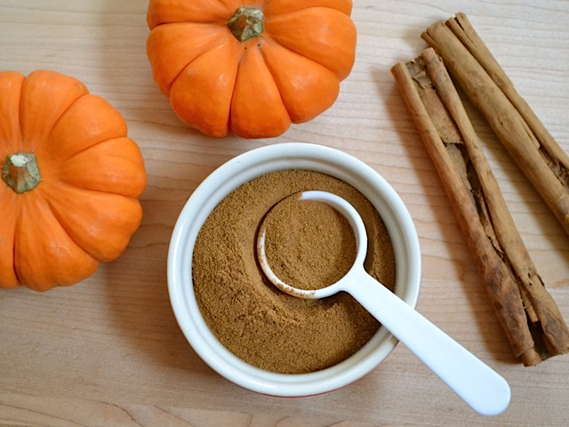
Then
Now

Slide 51
Nutmeg Grater
Nutmeg became an essential 17th Century ingredient in medicine as well as a culinary delight
Fashionable graters were made from ivory
Today we already buy nutmeg ground and do not need a grater

Slide 52
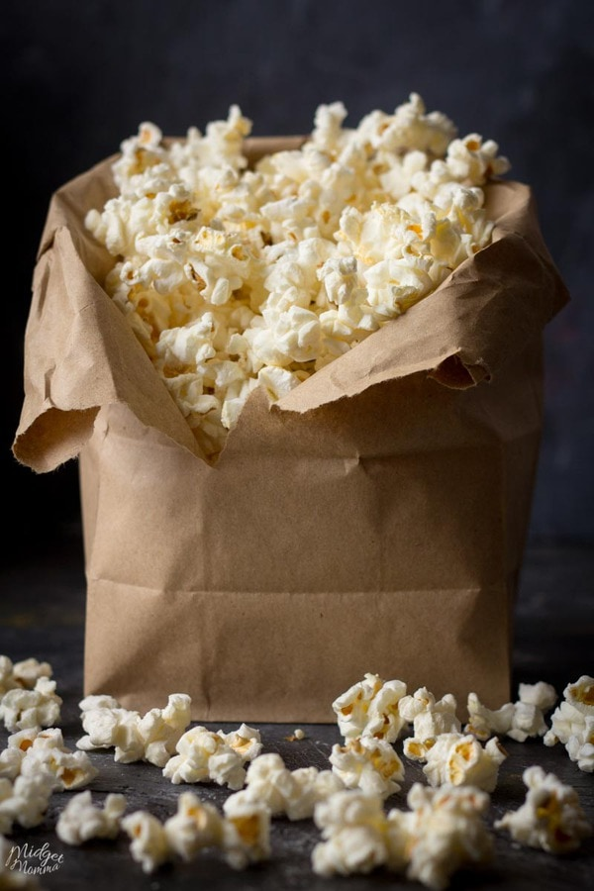
Then
Now
This Photo by Unknown Author is licensed under CC BY-NC-ND

Slide 53
Popcorn Popper
The first mention of popcorn in cookbooks was in 1846
Victorians made loads of popcorn for their holiday celebrations
Electric popcorn machines came about in the early 1900’s

Slide 54
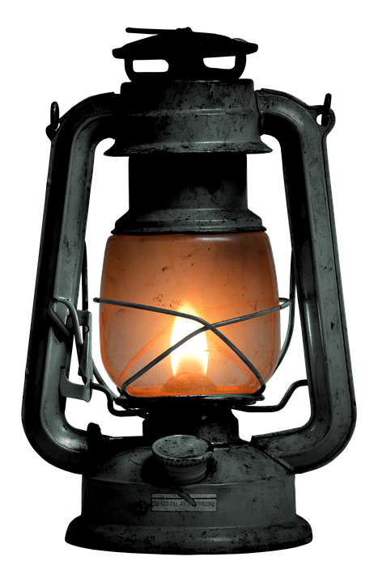
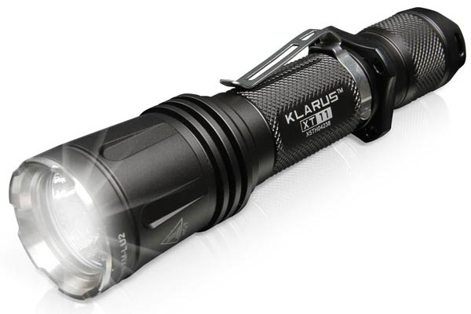
Then
Now

Slide 55
Lantern and Flashlight
A lantern’s primary use was to prevent the candles from extinguishing due to wind
Boston was the first city to introduce public lantern street lights
Countless patents for flashlights came to fruition in the early 1900’s and led to what we use today

Slide 56
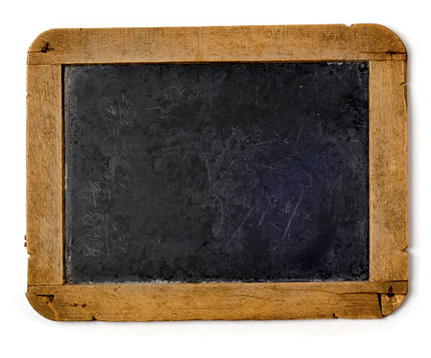
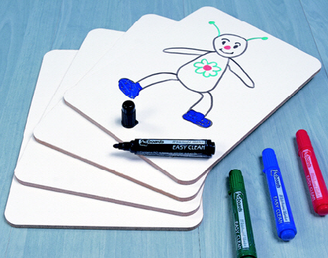
Then
Now

Slide 57
Writing Slate and Magna Doodle
Due to paper being so expensive, public schools turned to slate boards
A teacher in Scotland put the slate boards on the wall and thus created the chalkboard
The concern of allergies due to chalk dust led to the use of dry erase markers
The magna doodle is a commercialized toy for children to create designs on by using a series of magnetic pellets and a magnetized pen

Slide 58
Household Items
Then vs. Now
Recreated as an educational resource by Elmwood-Murdock FBLA

